Slide 1


ARTIFICIAL INTELLIGENCE
Subject code:(3161608)
SEM: 6
Branch: IT/ICT
Assistant Professor
IT-ICT Department, LJIET
prayag.patel@ljinstitutes.edu.in
Mr. Prayag Patel

Slide 2


What is AI ?
AI is the study of how to make computers do the things which at moment people do better.
AI is an area of computer science that emphasized the creation of Intelligent machines that work and react like Human.
Mr. Prayag Patel
Department: IT/ICT-LJIET

Slide 3
What is AI ?
AI has as one of its long term goals the development of machines that can do these things as well as humans can, or possibly even better.
The science and engineering of making intelligent machines, especially intelligent computer programs.
Artificial Intelligence is a way of making a computer, a computer-controlled robot, or a software think intelligently, in the similar manner the intelligent humans think.
AI is accomplished by studying how human brain thinks and how humans learn, decide, and work while trying to solve a problem, and then using the outcomes of this study as a basis of developing intelligent software and systems.
Mr. Prayag Patel
Department: IT/ICT-LJIET

Slide 4
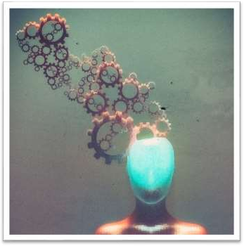
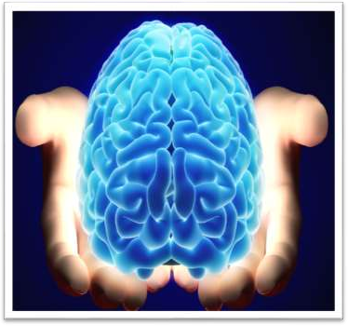
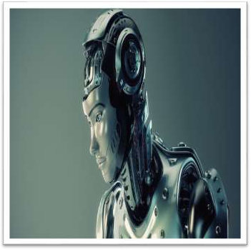

What is AI ?
ARTIFICIAL INTELLIGENCE
ARTIFICIAL
INTELLIGENCE
Intelligence: “The capacity to learn and solve problems”
Artificial Intelligence: Artificial intelligence (AI) is the simulation of human intelligence by machines.
  The ability to solve problems
  The ability to acquire and apply Knowledge.
  The ability to act like humans.
  The ability to manipulate and communicate ideas.
Mr. Prayag Patel
Department: IT/ICT-LJIET

Slide 5

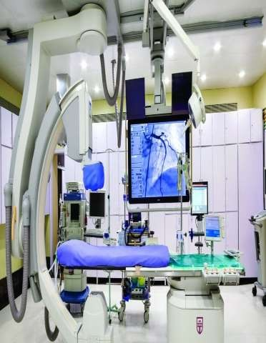
HEALTHCARE
Application of AI
Solving a variety of problems of patients, hospitals & healthcare industry overall.
Mr. Prayag Patel
Department: IT/ICT-LJIET

Slide 6

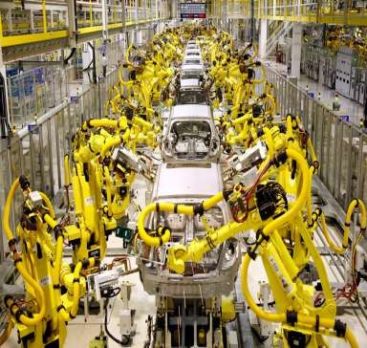
HEAVY INDUSTRY
Application of AI
Robots have become very common in many industries
Can do repetitive laborious tasks
Mr. Prayag Patel
Department: IT/ICT-LJIET

Slide 7


FINANCE
Application of AI
Algorithmic Trading
Market analysis & data mining
Personal Finance
Portfolio management
Mr. Prayag Patel
Department: IT/ICT-LJIET

Slide 8

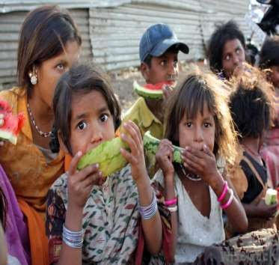
Application of AI
A.I. FOR GOOD
Analyse Satellite Images to identify which areas have the highest poverty level
Mr. Prayag Patel
Department: IT/ICT-LJIET

Slide 9

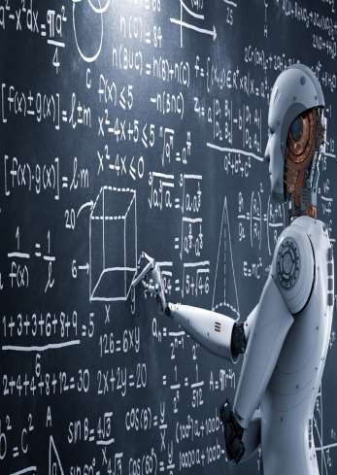
Application of AI
EDUCATION
Companies are creating robots to teach subjects
Mr. Prayag Patel
Department: IT/ICT-LJIET

Slide 10
Application of AI
Gaming
Mr. Prayag Patel
Department: IT/ICT-LJIET

Slide 11
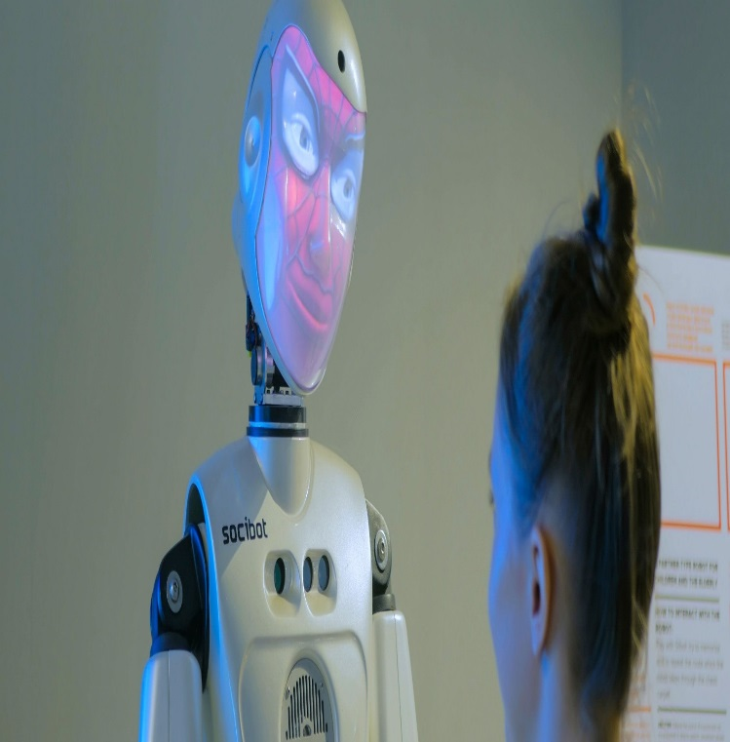
Application of AI
Computer Vision Systems
Mr. Prayag Patel
Department: IT/ICT-LJIET

Slide 12

Application of AI
Speech Recognition
Mr. Prayag Patel
Department: IT/ICT-LJIET

Slide 13
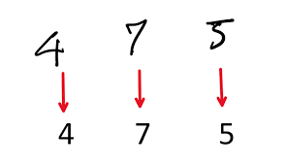
Application of AI
Handwriting Recognition
Mr. Prayag Patel
Department: IT/ICT-LJIET

Slide 14

Application of AI
Intelligent Robots
Robots sensors to detect physical data from the real world such as light, heat, temperature, movement, sound, bump, and pressure. In addition, they are capable of learning from their mistakes and they can adapt to the new environment.
Mr. Prayag Patel
Department: IT/ICT-LJIET

Slide 15
Maxmin Problem
X | X | O
X | O
 | O
Human
Max
WIN
X | X | O
X | O | X
 | O
X | X | O
X | O
X | O
X | X | O
X | O
 | O | X
Computer
Min
WIN
WIN
X | X | O
X | O | X
O | O
X | X | O
X | O | X
 | O | O
X | X | O
X | O
O | O | X
X | X | O
X | O | O
 | O | X
Human
Max
WIN
WIN
X | X | O
X | O | X
X | O | O
X | X | O
X | O | O
X | O | X
Computer
Min
Mr. Prayag Patel
Department: IT/ICT-LJIET

Slide 16
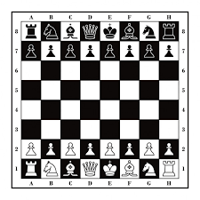
Chess Game
Initial State:
an 8 X 8 array square in which each element square (x, y), (x varying from 1 to 8 & y varying from 1 to 8) describes the board position of an appropriate piece in the official chess opening position.
Operations(Rules):
Legal moves are defined by a set of rules.
Goal State:
The goal can be any board position in which the opponent does not have a legal move and his or her “King” is under attack.
Mr. Prayag Patel
Department: IT/ICT-LJIET

Slide 17
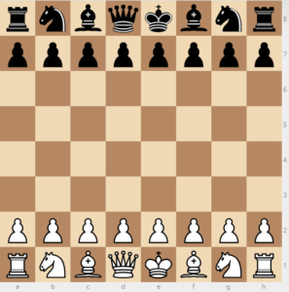
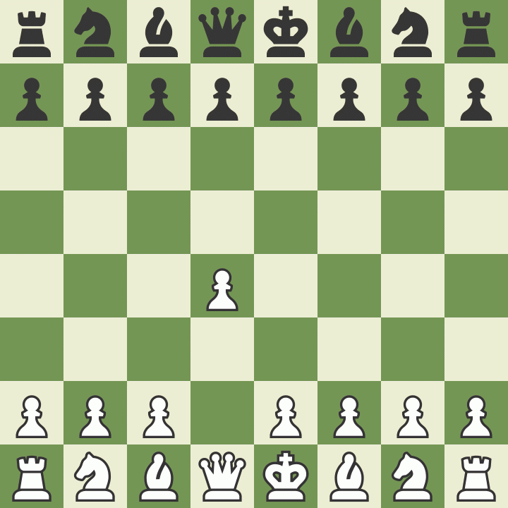
One legal Chess move
Chess Game
Mr. Prayag Patel
Department: IT/ICT-LJIET

Slide 18
Chess Game
White pawn at
square(file d, rank 2)
AND
square(file d, rank 3) is empty
AND
square(file d, rank 4) is empty
Move pawn from square(file d, rank 2) to square(file d, rank 4)
Mr. Prayag Patel
Department: IT/ICT-LJIET

Slide 19
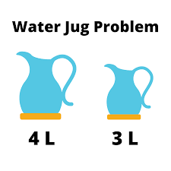
A Water Jug Problem
The state space for this problem can be described as the set of ordered pairs of integers(x,y), such that
(4 gallon jug , 3 gallon jug)
  x = 0,1,2,3,4
  y = 0,1,2,3
Start state(0,0)
Goal state(2,n)
Rules
Mr. Prayag Patel
Department: IT/ICT-LJIET

Slide 20
A Water Jug Problem
How can you get exactly 2-Gallon water into 4-Gallon jug?
Water in 4-Gallon jug | Water in 3-Gallon jug
0 | 0
0 | 3
3 | 0
3 | 3
4 | 2
0 | 2
2 | 0
Mr. Prayag Patel
Department: IT/ICT-LJIET

Slide 21
Blocks world problem
Initial state:
Goal state:
A
C
B
A
B
C
ON(C,A) ON(B,C) and ON(A,B)
Mr. Prayag Patel
Department: IT/ICT-LJIET

Slide 22
8-Puzzle
Initial state:
Goal state:
2 | 8 | 3
1 | 6 | 4
7 |  | 5
1 | 2 | 3
8 |  | 4
7 | 6 | 5
Mr. Prayag Patel
Department: IT/ICT-LJIET

Slide 23
Thank you

